Slide 1
Contingency Planning for Basic Education

Slide 2
OBJECTIVES
At the end of this module, participants are expected to:
To discuss the different steps in contingency planning for Basic Education
To draft a contingency plan for their respective schools
.
Notes:
SAY: At the end of this module, the participants are expected to…(read the objectives)

Slide 3
WHAT IS CONTINGENCY PLANNING?
Notes:
SAY: Who among you have experience/s in making contingency plan? Raise your hand. [(If several SAY: It’s good that most of you have the already involved in contingency planning, now this module will reinforced your knowledge and skills); (If few or no one SAY: This module will be beneficial for you since you have not been involved in contingency planning.)]
DO: Roam around the hall/ with the participants and ask some of them, what Contingency Planning is?
SAY: What do you think is contingency planning? Two-three answers will do.
DO: After getting ideas from the participants, proceed with the definition of what contingency planning is all about. Let the participants read the definition.

Slide 4

DEFINITION OF CONTINGENCY PLANNING
Republic Act No. 10121:
“A management process that analyzes specific potential events in a state of uncertainty and establishes response arrangements in advance to enable timely, effective and appropriate responses to such events and situations.”
Notes:
SAY: It is one of the identified mechanisms by the law in building disaster-resilient communities.
NOTE: Emphasize the following common points in the definitions from UNHCR and RA 1021:
SAY: Process- CP (Contingency Planning) follows a systematic series of steps that starts from assessing risks and ends with identification of goals, objectives, and actions to a scenario. It is not a haphazard activity.
SAY: Potential events or Expected scenario/situation - A potential event which may threaten the society signals the need to conduct CP. It involves making assumptions and developing scenarios upon which planning is based. (UNHCR & NDCC, 2007)
SAY: Conducted in advance- CP is conducted upon recognition of signs of a potential situation and thus, the plan is developed prior to the occurrence of a disaster and/or emergency.
SAY: Respond appropriately- CP aims at delivering responses promptly and appropriately by defining the objectives as well as actions to the expected scenario or event.

Slide 5
DEFINITION OF CONTINGENCY PLANNING
IFRC Contingency Planning Guide 2012:
“Aims to prepare an organization to respond well to an emergency and its potential humanitarian impact. It involves anticipating a specific hazard based on specific events or known risks at local, national, regional or even global levels (e.g., earthquakes, floods or disease outbreaks), and establishing operational procedures for response, based on expected resource requirements and capacity”
Notes:
SAY: It is one of the identified mechanisms by the law in building disaster-resilient communities.
NOTE: Emphasize the following common points in the definitions from UNHCR and RA 1021:
SAY: Process- CP (Contingency Planning) follows a systematic series of steps that starts from assessing risks and ends with identification of goals, objectives, and actions to a scenario. It is not a haphazard activity.
SAY: Potential events or Expected scenario/situation - A potential event which may threaten the society signals the need to conduct CP. It involves making assumptions and developing scenarios upon which planning is based. (UNHCR & NDCC, 2007)
SAY: Conducted in advance- CP is conducted upon recognition of signs of a potential situation and thus, the plan is developed prior to the occurrence of a disaster and/or emergency.
SAY: Respond appropriately- CP aims at delivering responses promptly and appropriately by defining the objectives as well as actions to the expected scenario or event.

Slide 6
CONTINGENCY PLAN
Salient Features:
Hazard-specific;
Flexible, revisited, and updated annually;
Preparedness plan turns into response actions which include alternative course of actions to address the gaps
Notes:
SAY:
Contingency Plan is Hazard-specific. The contingency plan intended for typhoon is not to be used for an earthquake however
Contingency Plan must also be Flexible (some parts of the plan can be tweak in order for it to be applicable to other hazard), Revisited and Updated every now and then. There are changes that must be taken into account in order to ensure that it will be effective.
Once a hazard turns into a disaster, the contingency plan which is a preparedness plan turns into response actions and this include alternative course of actions which will address the gaps in terms of capacities in the preparedness plan.

Slide 7
WHY CONTINGENCY PLANNING?
Notes:
SAY: Who among you have experience/s in making contingency plan? Raise your hand. [(If several SAY: It’s good that most of you have the already involved in contingency planning, now this module will reinforced your knowledge and skills); (If few or no one SAY: This module will be beneficial for you since you have not been involved in contingency planning.)]
DO: Roam around the hall/ with the participants and ask some of them, what Contingency Planning is?
SAY: What do you think is contingency planning? Two-three answers will do.
DO: After getting ideas from the participants, proceed with the definition of what contingency planning is all about. Let the participants read the definition.

Slide 8
WHY CONTINGENCY PLANNING?
CONTINGENCY PLANNING is our commitment to the Sendai Framework for Disaster Risk Reduction (SFDRR) 2015 - 2030
Notes:
DO: Let someone from the participants read the first reason.
SAY: The Philippines being one of the signatories in the Sendai Framework for Disaster Risk Reduction (SFDRR) 2015-2030, we are committed to conduct contingency planning. It is specifically stated in paragraph 33 of Priority 4 of the Framework that “…national and local governments shall prepare or review and periodically update disaster preparedness and contingency policies, plans and programs…”.

Slide 9
WHY CONTINGENCY PLANNING?
CP is required by RA 10121
Rule 6, Section 4 (3), Implementing Rules and Regulations (IRR) :
“The Provincial, City and Municipal DRRMOs or BDRRMCs, in coordination with concerned national agencies and instrumentalities, shall facilitate and support risk assessments and contingency planning activities at the local level.”
Notes:
DO: Let someone from the participants read what’s stated in the presentation.
SAY: In a localized context, RA 10121 required the conduct of contingency planning. It is implied specifically in Rule 6, Section 4 (3) of the Implementing Rules and Regulations (IRR) of the law stating that “The Provincial, City and Municipal DRRMOs or BDRRMCs, in coordination with concerned national agencies and instrumentalities, shall facilitate and support risk assessments and contingency planning activities at the local level.”

Slide 10
WHY CONTINGENCY PLANNING?
Other National Policies
National DRRM Framework
National Disaster Response Plan
EO No. 82 , s 2012
NDRRMC MC No 04, s. 2012
DBM-NDRRMC-DILG JMC 2013-1
NDRRMC-DILG-DBM-CSC JMC 2014-1
DILG Seal of Good Governance
DILG Project LISTO
Taken from OCD Presentation on Contingency Planning
Notes:
SAY: Also aside from RA 10121, the conduct of this preparedness measure is embodied in various national issuances, policies, programs and guidelines like NDRRM Framework, DILG Operation Listo and others.
SAY: Contingency planning is embodied in different international and national policies but at the same time, it is part of our preparedness for a specific hazard. Impact of disaster can be mitigated if there are effective prepared measure in place. It saves lives, property and other resources.

Slide 11
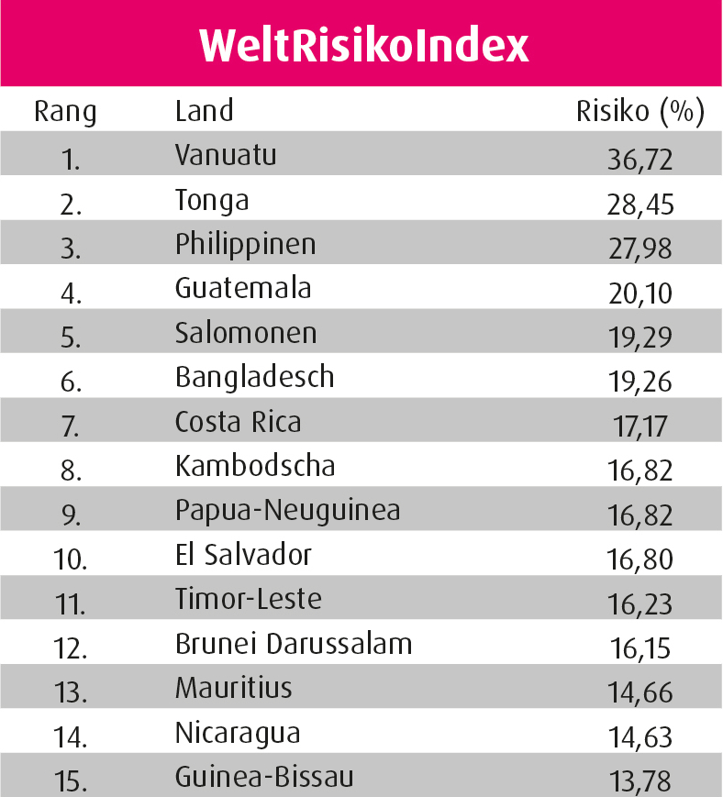
WHY CONTINGENCY PLANNING?
The Philippines is at risk to disasters
World Risk Index Report 2015
9th in 2009
6th in 2010
3rd in 2011 - 2013
2nd in 2014
3rd in 2015
Taken from OCD Presentation on Contingency Planning
Notes:
SAY: Philippines lies in the typhoon belt and the western segment of the Pacific Ocean Ring of Fire. This makes the country predisposed to natural hazards. On the average, 20 typhoons, of which 5 are destructive, hit the country every year. Examples are typhoons Yolanda, Ondoy, Ruby that claimed the lives of many Filipinos. As mentioned earlier, it lies along the Pacific Ring of Fire and thus, it is prone earthquakes. It also has 300 volcanoes of which 22 are active and 36,289 kms. of coastline that makes it vulnerable to tsunamis.
SAY: The risk brought by natural hazards can be compounded by human-induced hazards such as fire, land, air, and sea mishaps, hazardous material spills, etc. This could be associated with population growth, unplanned urbanization, migration and change in land use patterns. (UNHCR&NDCC, 2007)
SAY: The annual World Index Report (WIR) shows that Philippines climbed its way up from 9th in 2009 to 2nd in 2014 then 3rd in 2015 in the list of most at risk countries. Based on WIR, most of the countries at greater risk are developing countries.
SAY: At the end of the day, it all boil down to the reason that our country, the Philippines is at risk to disasters.

Slide 12
WHO ARE INVOLVED IN CONTINGENCY PLANNING?
Notes:
SAY: Who among you have experience/s in making contingency plan? Raise your hand. [(If several SAY: It’s good that most of you have the already involved in contingency planning, now this module will reinforced your knowledge and skills); (If few or no one SAY: This module will be beneficial for you since you have not been involved in contingency planning.)]
DO: Roam around the hall/ with the participants and ask some of them, what Contingency Planning is?
SAY: What do you think is contingency planning? Two-three answers will do.
DO: After getting ideas from the participants, proceed with the definition of what contingency planning is all about. Let the participants read the definition.

Slide 13
ACTORS IN CP PROCESS
Many heads are better than one
Taken from OCD Presentation on Contingency Planning
Notes:
SAY: As the saying goes, “many heads are better than one”. This maxim underlines the importance of collective effort and the need to tap the widest sources of knowledge and skills in CP.
SAY: Who are the key actors that need to be involved in the contingency planning for basic education? It must be well-represented with concerned stakeholders. In reality they are the one doing their own plan but ideally it should be a consultative workshop with different agencies/stakeholders concerned and involved.
SAY: Ideally, CP should involve actors from different areas of expertise, each with strong leadership, commitment and authority. It should bring together individuals and agencies to facilitate common understanding, avoid duplication of roles, and collectively fill-in the gaps in emergency response.
SAY: If the actors involved in CP have established mechanisms, clarified their roles and responsibilities, and streamlined the flow of communication and information, then they will be better able to work together, in a logical way, towards achieving their common objective.

Slide 14
ACTORS IN CP PROCESS
DRRM Focal Persons
Local P/C/M DRRMC member agencies reps.
National government agencies at the local level
Relevant technical experts
Relevant CSOs and private sector groups
Private sector managers or individuals willing to commit resources, services or any other form of assistance
Taken from OCD Presentation on Contingency Planning
Notes:
SAY: To come up with an appropriate, applicable and effective contingency plan, participation from key actors must be observed especially those that will be required to work together in the event of an emergency. Participants for the development of a contingency plan depends on the level or scope of the planning and working area. It can be national, regional or local which in the department’s end, it can be within DepEd Central Office, Regional, Division or School level.
SAY: External linkages and partner agencies or institutions also play a vital role in the contingency planning process. Moreover, inclusion of experts at different stages in the planning process is important. Their participation contribute to a more sound and well-coordinated response.

Slide 15
WHEN DO WE DO CONTINGENCY PLANNING?
Notes:
SAY: Who among you have experience/s in making contingency plan? Raise your hand. [(If several SAY: It’s good that most of you have the already involved in contingency planning, now this module will reinforced your knowledge and skills); (If few or no one SAY: This module will be beneficial for you since you have not been involved in contingency planning.)]
DO: Roam around the hall/ with the participants and ask some of them, what Contingency Planning is?
SAY: What do you think is contingency planning? Two-three answers will do.
DO: After getting ideas from the participants, proceed with the definition of what contingency planning is all about. Let the participants read the definition.

Slide 16
WHEN DO WE DO CONTINGENCY PLANNING?
2.
LATER, when we have more information ?
3.
JUST BEFORE
the event to maximise information ?
1.
As early
as NOW
4.
RIGHT AFTER the exact damage is known?
Taken from OCD Presentation on Contingency Planning
Notes:
DO: Solicit opinions regarding the best time to conduct CP by asking 1-2 volunteers from the group. Present the correct answer and explain why CP should be conducted as early as now.
NOTE: Highlight that we should start the CP NOW, by the moment we project a certain event to happen.
SAY: This allows timely delivery of responses and avoids loss of time to planning during the early phase of an emergency.
DO: Relate the responses of the participants to the correct answer.

Slide 17
WHEN DO WE DO CONTINGENCY PLANNING?
“It is better to plan when it is not needed, than not to have planned when it was necessary.”
Taken from OCD Presentation on Contingency Planning
Notes:
SAY: Even if one is not sure that such event may indeed occur, it is best to develop a plan

Slide 18
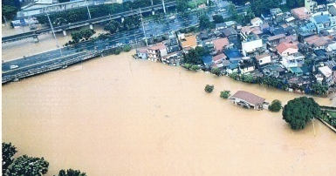
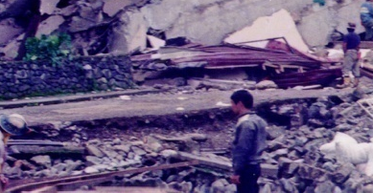
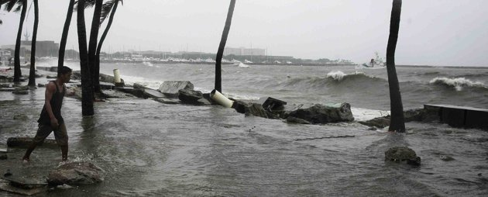
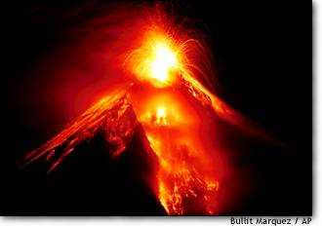
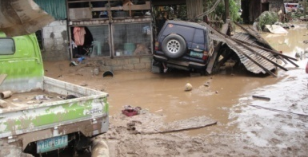
WHERE TO APPLY CONTINGENCY PLANNING?
Natural hazards
Human-induced hazards
Crises
Planned events
Sudden increase of displaced population
Sudden shortage of funding
Epidemic
Taken from OCD Presentation on Contingency Planning
Notes:
SAY: Events that require emergency responses are usually preceded by early warning signs. Knowledge on these early warning signs coupled with experience prompt one to recognize the need for CP. (UNHCR & NDCC, 2007)
SAY: Below are examples of hazards and events in which we can apply CP:
Natural hazards such as typhoons, volcanic eruptions, floods, El Niño and La Niña Phenomena, earthquakes, tsunamis, storm surge, landslides and lahar/mud flows
Human-induced incidents such as conflagration, aircraft crash, vehicular accident, oil spills, hazardous material incidents, garbage avalanche
Planned events such as fiestas, concerts, anniversaries, etc.
Crises such as bombing, terrorism and armed conflict
Sudden increase of displaced population
Sudden shortages of funding, food or other commodities
Outbreak of an epidemic or serious health problems
Problems
NOTE: You may breeze through the definition of early warning signs by mentioning that these are information that serve as indicators valuable for analysis to allow the prediction of a developing situation and the need to initiate action.

Slide 19
HOW TO DO CONTINGENCY PLANNING?
Notes:
SAY: Who among you have experience/s in making contingency plan? Raise your hand. [(If several SAY: It’s good that most of you have the already involved in contingency planning, now this module will reinforced your knowledge and skills); (If few or no one SAY: This module will be beneficial for you since you have not been involved in contingency planning.)]
DO: Roam around the hall/ with the participants and ask some of them, what Contingency Planning is?
SAY: What do you think is contingency planning? Two-three answers will do.
DO: After getting ideas from the participants, proceed with the definition of what contingency planning is all about. Let the participants read the definition.

Slide 20
Contingency Planning
A. Risk Assessment
A.1 Identification of Hazards
A.2 Analysis of Impacts
B. Response Capacity Mapping
B.1
Capacity Mapping
A.3 Prioritization
C. Developing, Strategies, Timeframe and Key Actors
B.2. Identification of Vulnerabilities/ Capacity Gaps
Notes:
RISK ASSESSMENT
SAY: As discussed earlier, contingency plan must be hazard-specific and before we come up with the hazard that we will have to make a contingency plan, we need first to identify what hazards are present or existing in your region/division/area.
So if you will look in your contingency planning guide, this will be the entry of the first chapter, the background of your locality. It will help you enumerate the hazards present in your area. Furthermore, it will enable you to understand why these hazards are existing.
Upon enumeration, you will be able to analyze the impacts of each hazard through historical data or records you have. In cases of typhoon, you have the consolidated RADaR, for other hazards such as earthquake, volcanic eruption, flooding, landslide and others, you can use official reports from concerned agencies such as PHIVOLCS, MGB, PAGASA, OCD, provincial/city/municipal government or even reports available in your office.
Through this, you will be able to know and see, which among these hazards are in need to have contingency plan immediately. This is where prioritization will come along. Refer to the DepEd Contingency Planning Guide Chapter IV for example.
B. RESPONSE CAPACITY MAPPING
SAY: The next step given the prioritized hazard is to map all the existing capacities of your region/division/area. Upon enumerating all existing capacities, it is where we can also delineate the vulnerabilities/weaknesses/capacity gaps.
This is one of the important and critical part in doing a contingency plan. This will the one which will determine whether you will have a successful and effective alternative response towards an unexpected occurrence of the hazard you are preparing for. Refer to Chapter V of the DepEd Contingency Planning Guide
C. DEVELOPING STRATEGIES, TIMEFRAME AND KEY ACTORS.
SAY: The identified capacity gaps/vulnerabilities/weaknesses will be the starting point in developing strategies or mechanisms to address it. What is the solution that can be done or can be used to fill in the gaps, turn the weakness into strength, the vulnerabilities into capacities?
Upon coming up with the mechanisms/strategies to address the capacity gaps, it will now be the time to set the deadline when it will must be set-up or facilitated. Defining the timeframe will help you or your division to have an ample amount of time to fix everything before the occurrence of expected hazard.
Aside from the timeframe, the key players in facilitating the strategies/mechanism to be used to address the capacity gaps must be clearly stated and informed. This will lead to a well-coordinated response when the expected hazard occur. This will also serve as the entry point for mobilizing partners and other resources that can be tapped.

Slide 21
KEY LEARNING
Contingency planning is a process of projecting scenario of natural or human induced hazard and at the same time delineating specific strategies to address capacity gaps in relation to the identified hazard. It also involves delineating specific roles to key actors together with the timeframe.
Contingency planning is required in different international and national policies and it is embodied in Preparedness.
Notes:
DO: Read one by one the key learning and briefly discuss each one.

Slide 22
KEY LEARNING
Contingency planning must be done as early as we projected a specific event.
Contingency planning must not rely on few or selected people but with several people especially those required to work together in the event of an emergency.
It can be applied to different events and as preparation to natural and human induced hazards.
The different processes involved in contingency planning are risk assessment, response capacity mapping and developing strategies, timeframe and key actors.
Notes:
DO: Read one by one the key learning and briefly discuss each one.

Slide 23
Thank You!

